Slide 1
UE Triggered Service Request
陳毅
Credit：陳煜盛

Slide 2
General
Service Request is triggered by
UE
5GC
Service Request is used to
activate a User Plane connection for an established PDU Session
release the connection to an AMF
The UE shall not initiate a Service Request procedure if there is an ongoing Service Request procedure.
Notes:
Service Request 可分為:
UE triggered Service Request
Network triggered Service Request
Service Request 目的是要激活 established PDU Session 的 User Plane 連線
如果有 ongoing Service Request procedure 則 UE 不應該發起 Service Request

Slide 3

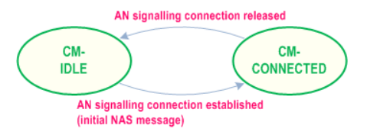
General
UE in CM-IDLE state initiates the Service Request in order to
send uplink signalling messages
send user data
request emergency services fallback
response to a network paging request
(optional) provides the Paging Restriction Information (Multi-USIM UE)
request removal of Paging Restriction Information (Multi-USIM UE)
respond to paging with a Reject Paging Indication (Multi-USIM UE)
N1 connection shall be released
no user plane connection shall be established
Notes:
UE 在 CM-IDLE 可能會為了以下情況而發起 Service Request:
傳送 uplink signalling messages
傳送 user data
請求 emergency services fallback
回應 network paging request
(選擇性地) 提供 Paging Restriction Information (Multi-USIM UE)
請求移除 Paging Restriction Information (Multi-USIM UE)
回應 paging 並伴隨著 Reject Paging Indication (Multi-USIM UE)
Paging Restriction Information: 這適用在 Multi-USIM 的情況下，當 USIM1想要節省 DL signaling 的資源，讓資源集中給 USIM2 使用，USIM1 此時限制核網做 Paging 的動作，讓UE及CN端都可以節省能源。 Reject Paging Indication : UE 可能因為自身限制，沒辦法回應 paging，所以必須在 Service Request 階段就要註明。

Slide 4
General
UE in CM-CONNECTED initiates the Service Request in order to
request activation of a User Plane connection for PDU Sessions
respond to a NAS Notification message from the AMF
request release of the UE connection
stop data transmission
discard of any pending data
(optional) store Paging Restriction Information
Notes:
UE 在 CM-CONNECTED state 發起 Service Request，為了以下目標:
請求激活 User Plane connection for PDU Sessions
回應 AMF 的 NAS Notification message
請求釋放 UE connection
停止資料傳輸
丟棄任何 pending data
(選擇性地) 儲存 Paging Restriction Information

Slide 5
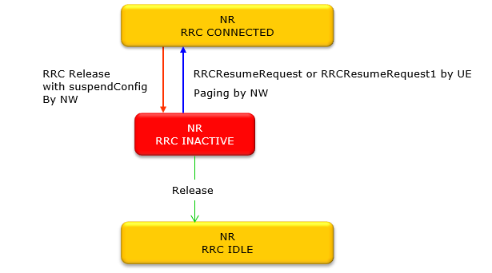
RRC & CM state
RRC_INACTIVE is introduced in R16
Especially, for Multi-USIM design
RRC_INACTIVE state can reduce
energy consumption
latency
Notes:
RRC inactive 是 R16 增加的 state，目的是讓 UE 端節省能源
在此 state 之下，核網仍然保有 UE context，並且會認為 UE 在 RRC Connected 的狀態
UE 想從 RRC Inactive 回到 Connected 只需透過 Random Access 步驟
在 RRC-inactive state 可以節省資源並減少延遲，這對 URLLC 很有幫助

Slide 6
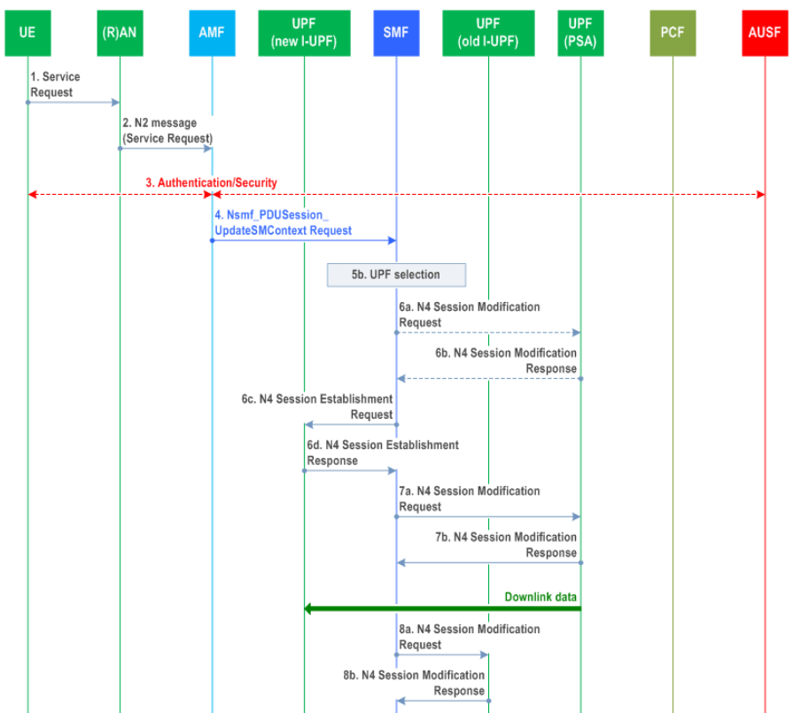

Slide 7
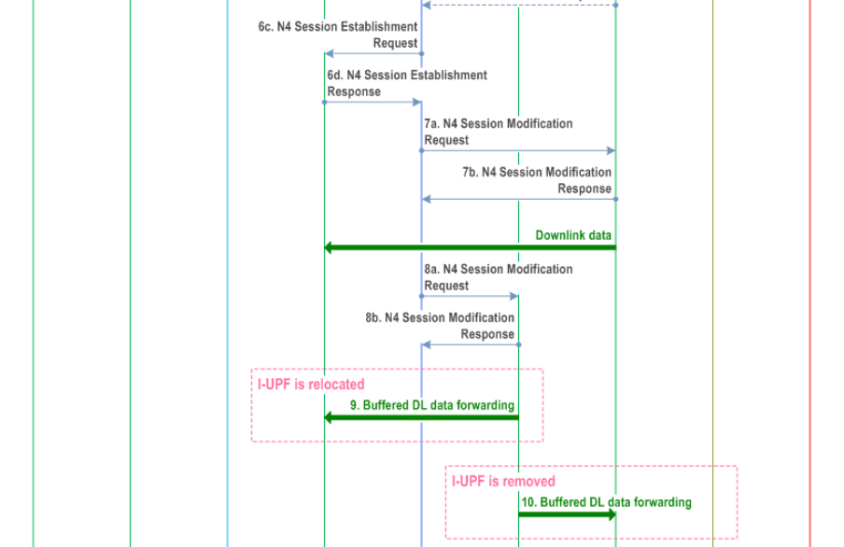

Slide 8
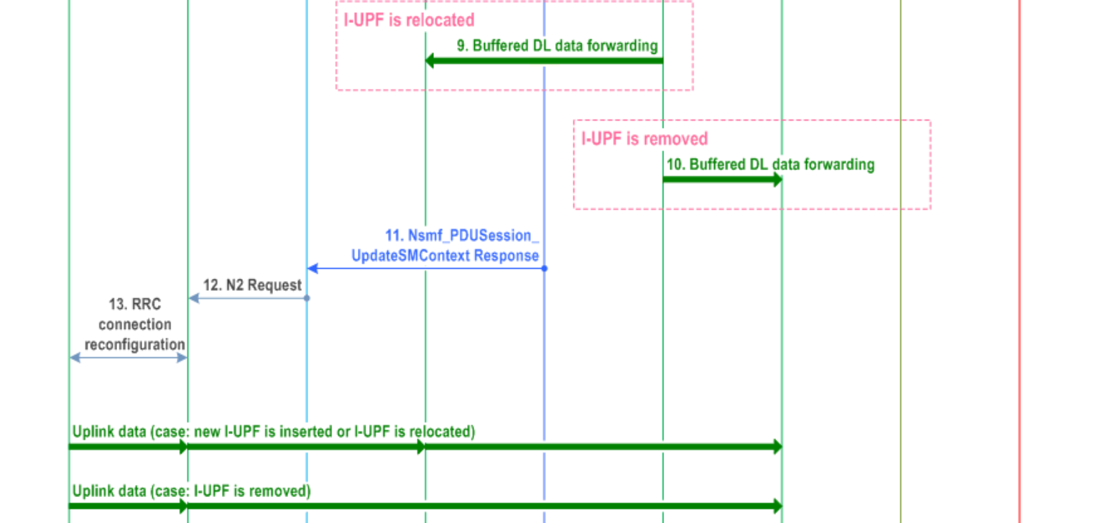

Slide 9
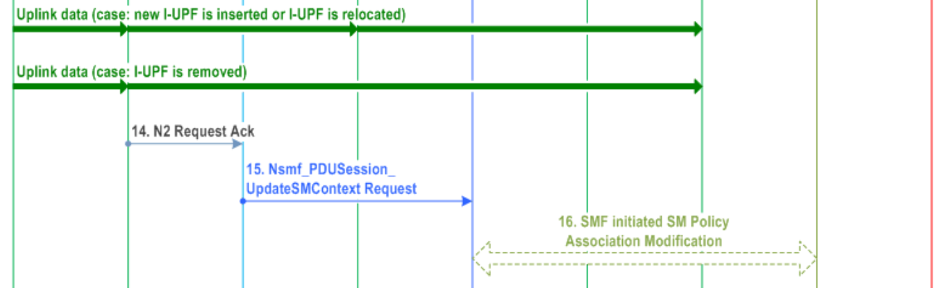

Slide 10
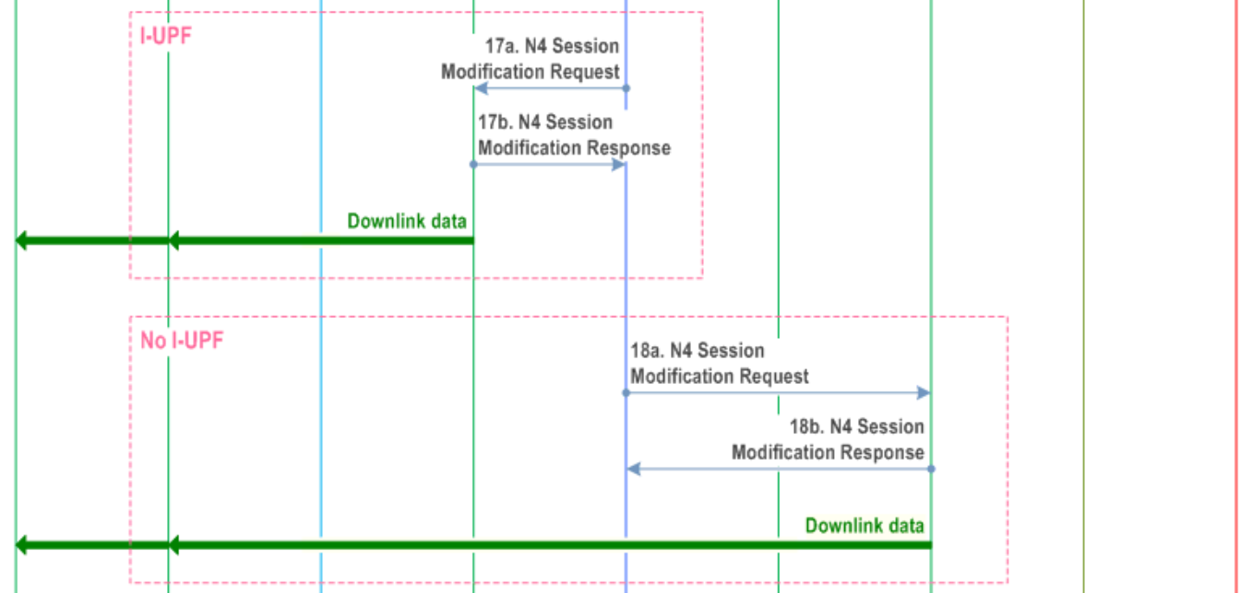

Slide 11
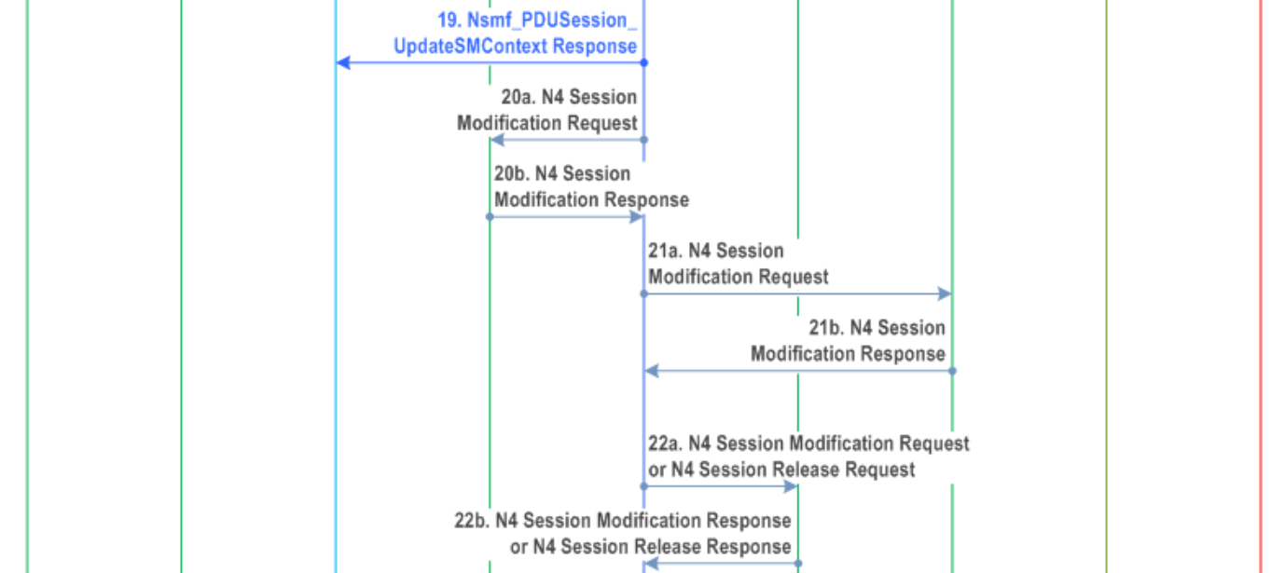

Slide 12
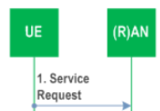
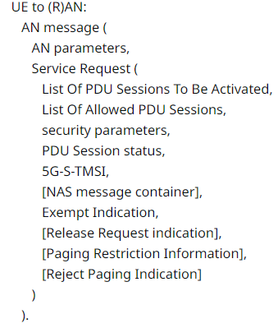
Step 1
NAS message container shall be included if
UE is sending a Service Request message as an Initial NAS message; and
UE needs to send non-cleartext IEs
Notes:
如果 UE 傳送 Service Request 當作是 Initial NAS message，並且 UE 需要傳送 non-cleartext 的 IE 給 AMF，那就 Service Request 必須要包含 NAS message container

Slide 13
Step 1
If the Multi-USIM UE intends to leave CM-CONNECTED state, it may include:
Release Request indication is included
Paging Restriction Information is included
If the Multi-USIM UE in CM-IDLE state intends to delete the Paging Restriction Information
Release Request indication is included
Paging Restriction Information is not included
Notes:
如果 Multi-USIM UE 想要離開 CM-CONNECTED state，它可能包含 Release Request indication，或選擇性地放入 Paging Restriction Information。
如果 Multi-USIM UE 在 CM-IDLE state 意圖想要刪除 Paging Restriction Information，則
Release Request indication 會被包含進去
Paging Restriction Information 不會被包含進去

Slide 14
Step 1
If the Multi-USIM UE in CM-IDLE state decides not to accept the paging:
Reject Paging Indication is included
(optionally) Paging Restriction Information
Notes:
如果在 CM-IDLE 狀態的 Multi-USIM UE 決定拒絕收 paging，則必須 Service Request 必須包含:
- Reject Paging Indication
選擇性的放入 Paging Restriction Information

Slide 15
Step 1
Multi-USIM UE | Release Request indication | Paging Restriction Information | Reject Paging Indication
In CM-CONNECTED intends to leave CM-CONNECTED state | v | v
in CM-IDLE intends to delete the Paging Restriction Information | v
in CM-IDLE decides not to accept the paging |  | optional | v
Notes:
剛才的兩頁投影片，總結下來就是這張表

Slide 16
Step 1
If UE wants to re-activate the PDU Session(s)
UE provides List Of PDU Sessions To Be Activated
The List Of Allowed PDU Sessions is provided when the Service Request is a response of
a Paging; or
a NAS Notification for a PDU Session associated with non-3GPP access and identifies the PDU Sessions that can be transferred to 3GPP access.
Notes:
如果 UE 想要重新 activate PDU Session，它會提供 List Of PDU Sessions To Be Activated。 如果這個 Service Request 是
- Paging 的 response; 或者
- NAS Notification 的 response 告訴 UE 這個 non-3GPP access 的 PDU Session 可以被轉換為 3GPP access
那這個 Service Request 就會包含 List Of Allowed PDU Sessions

Slide 17
Step 1
UE only includes minimum number of PDU Session(s) in List Of PDU Sessions To Be Activated
UE shall include always-on PDU Sessions even if
there are no pending uplink data; or
when the Service Request is triggered for signalling only; or
when the Service Request is triggered for paging response
Notes:
UE 只將最小數量的 PDU Session(s) 包含進 List Of PDU Sessions To Be Activated
UE 應該要包含 always-on PDU Sessions，即使是以下情況:
沒有 pending uplink data; 或者
Service Request 只是為了 signaling 而被觸發; 或者
Service Request 是被 paging 觸發

Slide 18
Step 1
For UE in CM-CONNECTED state, only
the List Of PDU Sessions To Be Activated
List Of Allowed PDU Sessions
need to be included in the Service Request.
Notes:
若 UE 在 CM-CONNECTED state，只有
List Of PDU Sessions To Be Activated
List Of Allowed PDU Sessions
會被包含在 Service Request 之中

Slide 19
Step 1
AN parameters
5G-S-TMSI
Selected PLMN ID
Establishment cause
NSSAI information
Notes:
AN parameters 包含:
5G-S-TMSI
Selected PLMN ID
RRC Establishment cause
NSSAI information

Slide 20
Step 1
PDU Session status
indicates the PDU Sessions available in the UE
A PDU Session corresponding to a LADN is not included in the List Of PDU Sessions To Be Activated when the UE is outside the area of availability of the LADN.
Notes:
PDU Session status 顯示了 PDU Sessions 在 UE 內的可用性
當 UE 位處在 LADN 的可用範圍之外時，UE 不應該把對應到此 LADN 的 PDU Session 包進 List Of PDU Sessions To Be Activated

Slide 21
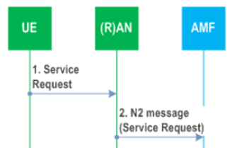
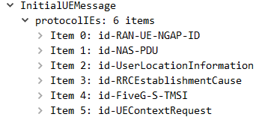
Step 2
N2 Message (N2 parameters, Service Request)
N2 parameters
5G-S-TMSI
Selected PLMN ID
Location information
Establishment cause
UE Context Request
Wireshark
Notes:
N2 message 包含了 N2 parameters 及 Service Request
N2 parameter 包含了:
- 5G-S-TMSI
- Selected PLMN ID
- Location information
- Establishment cause
- UE Context Request

Slide 22
Step 2
If the UE is in CM-IDLE state, the NG-RAN obtains the 5G-S-TMSI in RRC procedure.
NG-RAN selects the AMF according to 5G-S-TMSI.
The Location Information relates to the cell in which the UE is camping.
Notes:
如果 UE 在 CM-IDLE state，NG-RAN 會在 RRC procedure 階段獲得 5G-S-TMSI
NG-RAN 根據 AMF 選擇 5G-S-TMSI
Location Information 顯示了 UE 目前位於的 cell

Slide 23
Step 2
AMF may initiate PDU Session Release procedure, based on the PDU Session status
When the Establishment cause is associated with priority services (MPS, MCX, …), or when the AMF determines that the UE has priority subscription
AMF includes a Message Priority header
Other NFs relay the priority information by including the Message Priority header in service-based interfaces
The AMF enforces the Mobility Restrictions in this step (clause 5.3.4.1.1 of TS 23.501)
Notes:
AMF 會基於 PDU Session status 決定是否發起 PDU Session Release procedure
當 Establishment cause 是跟 priority services 有關 (例如 MPS, MCX)，或者當 AMF 決定 UE 擁有優先的訂閱
- AMF 會包含 Message Priority header
- 其他的 NF 在 SBI 內會透過 Message Priority header 傳送 priority 的資訊
AMF 會在此步驟執行 Mobility Restrictions
MPS (Multimedia Priority Services)
MCX (Mission Critical Services)

Slide 24
Step 2
Mobility Restrictions consist of:
RAT restriction
Forbidden Area
Service Area Restrictions
Core Network type restriction
Closed Access Group information
Notes:
Mobility Restrictions 包含了
- RAT restriction
Forbidden Area
Service Area Restrictions
Core Network type restriction
Closed Access Group information

Slide 25
Step 2
AMF rejects the Service Request if
there is a Service Gap timer running &&
the AMF is not waiting for a MT paging response &&
the Service Request is not for regulatory prioritized services (e.g. Emergency services) &&
not for exception reporting
In addition, AMF may also provide a UE with a Mobility Management Back-off timer set to the remaining value of the Service Gap timer.
Notes:
AMF 在以下情況下會 Reject Service Request
如果在 AMF 有一個 Service Gap timer 正在跑，且
AMF 沒有在等 MT paging response，且
Service Request 不是用來 regulatory prioritized services (例如 Emergency services)，且
不是為了 exception reporting
除此之外，AMF 也可能提供 UE 一個 Mobility Management Back-off timer，並將數值調整為剩餘的 Service Gap timer 的時間。

Slide 26
Step 2
If the AMF supports RACS and the AMF detects that the selected PLMN is different from the currently registered PLMN
AMF determines the UE Radio Capability ID of the newly selected PLMN to the gNB
RACS: Radio Capability Signaling Optimization (R16)
due to additional supported bands and other features
Notes:
如果 AMF 支援 RACS 並且 AMF 偵測到 UE 選擇的 PLMN 不同於目前註冊到的 PLMN，則 AMF 會決定給 UE 一個 UE Radio Capability ID
RACS 是為了要支援額外的 band 或其他的 features，而在 R16 所發展的技術

Slide 27
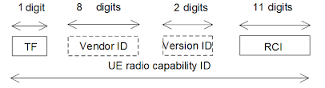
RACS: Radio Capability Signaling Optimization
UE Radio Capability ID (3GPP 23.003)
TF - Type Field: identifies the type of UE radio capability ID
0: manufacturer-assigned UE radio capability ID
1: network-assigned UE radio capability ID
Vendor ID: identifier of UE manufacturer and only present if TF = 0
Version ID: configured by the UE Capability Management Function (UCMF) that is part of the EPS/5GC
Radio Configuration Identifier (RCI) identifies the UE radio configuration
Notes:
RACS 有個很重要的 ID 就是 UE Radio Capability ID，包含了
TF: 0 是 manufacturer-assigned 的 UE radio capability ID; 1 則是 network-assigned 的 UE radio capability ID
核網可以支援其中一種或是兩種都支援
Vendor ID : UE 製造商的 ID，TF = 0 的時候才需要有內容
Version ID : 此欄位是由 UCMF 所設定的 (UCMF 掌管 RACS ID 與 UE 之間的 mapping)
Radio Configuration Identifier (RCI): 標示了 UE radio configuration

Slide 28
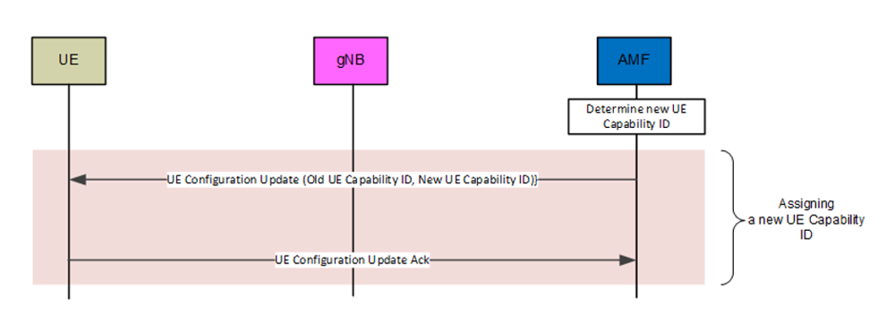
RACS: Radio Capability Signaling Optimization
Notes:
此圖示範了 network-assigned UE Radio Capability ID 的 scenario

Slide 29
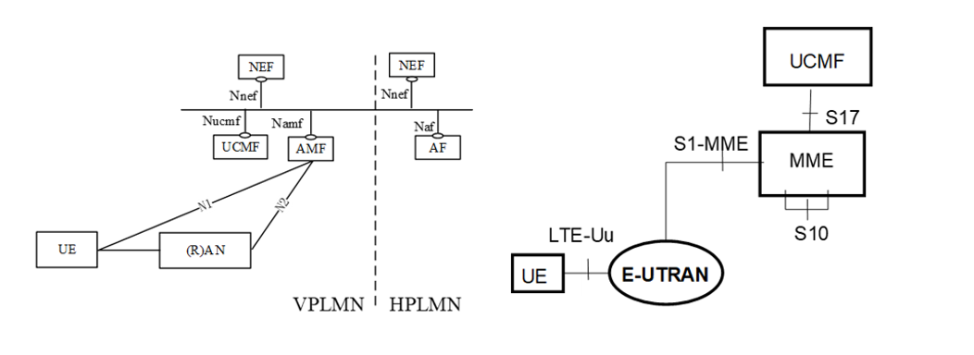
RACS: Radio Capability Signaling Optimization
UCMF: UE radio Capability Management Function

Slide 30
Step 3a
AMF to (R)AN: N2 Request
Security Context
Mobility Restriction List
list of recommended cells / TAs / NG-RAN node identifiers
If the 5G-AN had requested for UE Context or there is a requirement for AMF to provide UE Context
AMF initiates NGAP procedure
gNB
AMF
AMF
gNB
gNB
AMF
Wireshark (idle mode uplink service request)
Notes:
AMF 會傳送 N2 Request 給 RAN，包含了:
Security Context
Mobility Restriction List
list of recommended cells / TAs / NG-RAN node identifiers
如果 5G-AN 已經請求 UE Context，或者有必要請 AMF 提供 UE Context
- AMF 會發起 NGAP procedure

Slide 31
Step 3a
For UE in CM-IDLE state, 5G-AN stores the Security Context in the UE AN Context
The 5G-AN uses the Security Context to protect the messages exchanged with the UE
If the NG-RAN node had provided the list of recommended cells / TAs / NG-RAN node identifiers during the AN Release procedure
the AMF shall include it in the N2 Request
RAN may use this information to allocate the RAN Notification Area when the RAN decides to enable RRC_INACTIVE state for the UE.
Notes:
若 UE 在 CM-IDLE state，5G-AN 會將 Security Context 儲存進 UE AN Context
- 5G-AN 會使用 Security Context 來保護與 UE 之間的訊息交換
如果 NG-RAN node 已經提供了 list of recommended cells / TAs / NG-RAN node identifiers，則
AMF 應該要將它包含進 N2 Request
當 RAN 決定要允許 UE 使用 RRC-inactive state ，RAN 可能會用此資訊來分配 RAN Notification Area

Slide 32
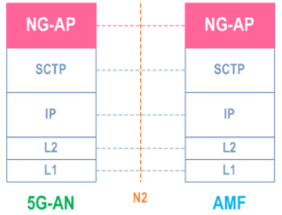
NGAP Procedures TS 38.413
AMF Configuration Update
RAN Configuration Update
Handover
Cancellation
Preparation
Resource Allocation
Initial Context Setup
NG Reset
NG Setup
Path Switch Request
PDU Session Resource
Modify
Modify Indication
Release
Setup
UE Context
Modification
Release
Suspend
Resume
Write-Replace Warning
PWS Cancel
UE Radio Capability
Check
ID Mapping
Broadcast Session
Setup
Modification
Release
Distribution
Setup
Release
Multicast Session
Activation
Deactivation
Update
Notes:
這邊列出了所有 NGAP Procedure 供各位參考

Slide 33
Step 3
If the Service Request was not sent integrity protected or integrity protection verification failed, the AMF shall reject the Service Request.
If the UE in CM-IDLE state triggered the Service Request to establish a signalling connection only, after successful establishment of the signalling connection the UE and the network can exchange NAS signalling and steps 4~11 and 15~22 are skipped.
Notes:
如果 Service Request 沒有以整合性保護，或者整合性保護失敗，則 AMF 應該 reject Service Request
如果 UE 在 CM-IDLE state 觸發 Service Request 只為了建立 signalling connect，在成功建立 signaling connection 之後， UE 及 network 就可以交換 NAS signaling 並且步驟 4-11, 15-22 可以跳過

Slide 34
Step 3
If the Service Request message is received over 3GPP access without
Release Request indication
Reject Paging Indication
=> the AMF shall delete any stored Paging Restriction Information for this UE and stop restricting paging accordingly.
Notes:
如果 Service Request message 是 over 3GPP access 並且不帶有
- Release Request indication
Reject Paging Indication
則 AMF 應該要刪除任何 stored Paging Restriction Information 並停止限制 paging

Slide 35
Step 3
If the Service Request message over 3GPP access includes a Release Request indication or a Reject Paging Indication, then:
the AMF may accept or reject the received Paging Restriction Information requested by the UE based on operator policy.
If no Paging Restriction Information is provided, no paging restrictions apply and the AMF removes any stored Paging Restriction Information from the UE context.
no User Plane resources are established and instead the AMF triggers the AN Release procedure
Notes:
如果 Service Request message over 3GPP access 包含了 Release Request indication 或 Reject Paging Indication 則:
AMF 可能會根據 operator policy 接受或拒絕 Paging Restriction Information
如果Service Request 沒有提供 Paging Restriction Information ，則不會 apply 任何 pagin restrictions 並且 AMF 會對 UE context 移除任何 stored Paging Restriction Information
沒有 User Plane 資源會被建立並且 AMF 會觸發 AN Release procedure

Slide 36
Step 4
Nsmf_PDUSession_UpdateSMContext Request
PDU Session ID(s)
Operation Type
UE location information
Access Type
RAT Type
UE presence in LADN service area
Indication of Access Type can be changed
[MO Exception Data Counter]
Notes:
AMF 送給 SMF 的 Nsmf_PDUSession_UpdateSMContext Request 包含:
- PDU Session ID(s)
- Operation Type
- UE location information
- Access Type
- RAT Type
- UE presence in LADN service area
- Indication of Access Type can be changed
- [MO Exception Data Counter]

Slide 37
Step 4
Nsmf_PDUSession_UpdateSMContext is invoked:
If the UE identifies List Of PDU Sessions To Be Activated in the Service Request message; or
If this procedure is triggered by the SMF in response to paging or NAS notification indicating 3GPP access; or
If this step onwards is invoked following step 4a of clause 4.2.3.3 and the current UE location
is outside the "Area of validity for the N2 SM information" provided by the SMF; or
the "Area of validity for the N2 SM information" was not provided by the SMF
If this procedure is triggered by the SMF in response to paging or NAS notification indicating non-3GPP access and the AMF
received N2 SM Information only; or
both N1 SM Container and N2 SM Information
Notes:
Nsmf_PDUSession_UpdateSMContext 被觸發的條件如下:
如果 UE 在服務請求消息中識別到要激活的 PDU 會話列表；或者
如果此 Service Request 是被 SMF 所觸發， 為了回應 paging 或顯示為 3GPP access 的 NAS notification; 或者
如果根據4.2.3.3條款的第4a步驟後，並且當前的UE位置為
超出SMF提供的 Area of validity for the N2 SM information”；或者
SMF未提供 Area of validity for the N2 SM information。
如果此過程是由 SMF 觸發，為了回應 paging 或顯示為 non-3GPP access NAS notification 且 AMF
僅收到 N2 SM 信息；或者
N1 SM Container 及 N2 SM Information 都有收到。

Slide 38
Step 4
If the DNN corresponds to an LADN
the "UE presence in LADN service area" indicates if the UE is IN or OUT of the LADN service area.
If the AMF does not provide the "UE presence in LADN service area" indication and the SMF determines that the DNN corresponds to a LADN
SMF considers that the UE is OUT of the LADN service area.
Notes:
如果 DNN 符合 LADN
UE presence in LADN service area 欄位，顯示 UE 是在 LADN service area 裡面還是外面
如果 AMF 沒有提供 UE presence in LADN service area 並且 SMF 斷定 DNN 符合 LADN
- SMF 會斷定 UE 是在 LADN service area 外面

Slide 39
Step 4
The AMF determines the PDU Session(s) for which the UP connection(s) shall be activated and sends an Nsmf_PDUSession_UpdateSMContext Request to SMF(s) associated with the PDU Session(s)
set Operation Type = "UP activate"
AMF determines
Access Type
RAT Type
If the RAT type == NB-IoT, AMF shall ensure that the number of activated PDU session(s) are not exceed UE's maximum number of supported user plane resources
Notes:
如果 AMF 決定某 PDU Session(s) 的 UP connection(s) 應該要被 activated 並且傳送一個 Nsmf_PDUSession_UpdateSMContext Request 給 SMF(s)，並且把 Operation Type 設定為 UP activate。
AMF 會先決定
Access Type
RAT Type
- 如果 RAT type 為 NB-IoT，AMF 應該要確保 activated PDU session 的數量沒有超過 UE 支援的 user plane resources 最大數量

Slide 40
Step 4
If the procedure was triggered in response to paging or NAS Notification indicating non-3GPP access, the behavior of PDU Session:
PDU Session | Not in List Of PDU Sessions To Be Activated | In List Of PDU Sessions To Be Activated
Not in List Of Allowed PDU Sessions | AMF notifies the SMF that the UE is not reachable.
In List Of Allowed PDU Sessions | Service Request Procedure succeeds without re-activating the User Plane | Service Request Procedure succeeds with re-activating the User Plane
Notes:
如果 Serivce request 的 procedure 被觸發的原因是為了要回應 Paging 或是回應顯示為 non-3GPP access 的 NAS Notification，則 PDU Session 的行為如下表:

Slide 41
Step 4
If the UE is accessing via the NB-IoT RAT,
the AMF may inform all (H-)SMFs whether the RRC establishment cause is set to "MO exception data“.
The AMF may immediately send the MO Exception Data Counter to the (H-)SMF.
Notes:
如果 UE 透過 NB-IoT RAT 來存取核網，則:
AMF 會通知所有的 SMF，RRC establishment cause 是否被設定為 MO exception data
AMF 會立即地傳送 MO Exception Data Counter 給 SMF

Slide 42
Step 4
The AMF may receive a Service Request to establish another NAS signalling connection via a new NG-RAN while it has maintained an old NAS signalling connection for UE still via an old NG-RAN.
The new NG-RAN and the old NG-RAN can be the same NG-RAN node.
AMF shall trigger the AN Release procedure toward the old NG-RAN
For the PDU Sessions indicated by the UE in the List Of PDU Sessions To Be Activated, the AMF requests the SMF to activate the PDU Session(s) immediately by performing this step 4; and
For the PDU Sessions indicated by the old NG-RAN in the "List of PDU Session ID(s) with active N3 user plane" but not in the List Of PDU Sessions To Be Activated sent by the UE, the AMF requests the SMF to deactivate the PDU Session(s).
Notes:
AMF 可能會從收到 Service Request 請求新的 NAS signalling connection 透過新的 NG –RAN，但 AMF 仍然在維護舊的 NAS signalling connection 透過舊的 NG-RAN，此時:
新的 NG-RAN 與舊的 NG-RAN 可能相同
AMF 應該要對舊的 NG-RAN 觸發 AN Release procedure
針對在 List Of PDU Sessions To Be Activated 裡面的 PDU Sessions，AMF 會請求 SMF 立即 activate 這些 PDU Sessions

Slide 43
Step 5a (conditional)
SMF -> PCF
If the AMF notified the SMF that the access type of the PDU session can be changed in step 4, and if PCC is deployed
the SMF perform an SMF initiated SM Policy Association Modification procedure
if Policy Control Request Trigger condition(s) have been met (i.e. change of Access Type). The PCF may provide updated PCC Rule(s).
Notes:
如果 AMF 通知 SMF PDU session 的 access type 可以在步驟4更改，並且如果 PCC(policy and charging control) 已經部署，則 SMF 發起 SM Policy Association Modification流程(4.16.5.1) 如果Policy Control Request 觸發條件已經滿足（例如change of Access Type），PCF 可提供 updated PCC Rule

Slide 44
Step 5b
If the PDU Session ID corresponds to a LADN and the SMF determines that the UE is outside the area of availability of the LADN based on the "UE presence in LADN service area" from the AMF, the SMF decides to (based on local policies) either:
keep the PDU Session, but reject the activation of User Plane connection for the PDU Session and inform the AMF about it. If the procedure has been triggered by a Network Triggered Service Request as described in clause 4.3.2.3, the SMF may notify the UPF that originated the Data Notification to discard downlink data for the PDU Sessions and/or to not provide further Data Notification messages; or
to release the PDU Session: the SMF releases the PDU Session and informs the AMF that the PDU Session is released.
Notes:
如果 PDU Session ID 對應一個 LADN （本地數據網路），基於從AMF得到的“UE presence in LADN service area”，SMF判定UE在可用的LADN之外，則SMF根據local政策有兩種做法:
- 保持PDU Session，但拒絕 the activation of User Plane connection for the PDU Session並通知 AMF。如果此流程由Network Triggered Service Request(4.2.3.3)觸發。 SMF可以通知UPF放棄PDU Session的downlink data，或者不提供進一步的Data Notification messages
- 直接釋放PDU Session，SMF釋放PDU Session並通知AMF PDU Session已經釋放

Slide 45
Step 5b
Otherwise, based on the location info received from the AMF, the SMF checks the UPF Selection Criteria and determines to perform one of the following:
accepts the activation of UP connection and continue using the current UPF(s)
accepts the activation of UP connection and selects a new intermediate UPF (or add/remove an intermediate UPF), if the UE has moved out of the service area of the UPF that was previously connecting to the AN, while maintaining the UPF(s) acting as PDU Session Anchor; or
rejects the activation of UP connection of a PDU Session of SSC mode 2 and trigger re-establishment of the PDU Session after Service Request procedure to perform the allocation of a new UPF to act as PDU Session Anchor.
Notes:
如果不是上面的狀況，基於從 AMF 接收到的 location info，SMF 根據 UPF Selection 標準(23.501 6.3.3)，決定執行以下其一：
- 接受 the activation of UP connection 並且繼續使用目前的 UPF(s)
- 接受 the activation of UP connection，並選擇一個新的 intermediate UPF（新增/移除一個 intermediate UPF），如果UE已經不在先前連接到 AN 的 UPF 服務區，則會維持此 UPF 作為 PDU Session Anchor。
- 拒絕 SSC mode 2 的 PDU Session 的 activation of UP connection，觸發重新建立 PDU Session，在 Service Request procedure 後分配一個新的 UPF 作為 PDU Session Anchor

Slide 46
Step 5b
In the case that the SMF fails to find suitable I-UPF, the SMF decides to (based on local policies) either:
trigger re-establishment of PDU Session. After Service Request procedure, SMF sends N1 SM message to the UE via the AMF by invoking Namf_Communication_N1N2MessageTransfer containing the cause indicating PDU Session re-establishment is required for the UE; or
keep the PDU Session, but reject the activation request of User Plane connection for the PDU Session and inform the AMF about it; or
release the PDU Session after Service Request procedure.
Notes:
在 SMF 找不到一個合適的 I-UPF 的情況下，SMF 基於local政策決定做出以下其中一種行為:
觸發 re-establishment of PDU Session。在 Service Request Procedure 之後 SMF 傳送 N1 SM message 給 UE 經由 AMF 透過觸發 Namf_Communication_N1N2MessageTransfer 包含了為何要 PDU Session re-establishment 的原因給 UE; 或者
維持 PDU Session，但拒絕 activate UP connection 的請求並通知 AMF; 或者
釋放 PDU Session

Slide 47
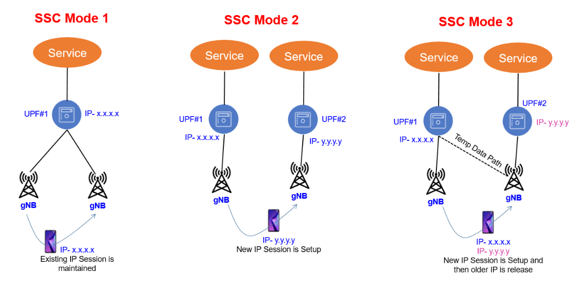
SSC (Session and Service Continuity) mode
Notes:
此頁呈現了三種 SSC mode:
Mode 1: 只有使用一個 UPF (PSA)，當我們換手到另一個 gNB 時，IP 不改變，I-UPF 可能會有所變動，但 UPF (PSA) 始終不變，直到 UE 釋放 PDU Session，確保 connectivity。
Mode 2: 有多個 UPF，當要切換路徑的時候，IP 會改變，並且順序是先釋放 PDU Session 再重新建立一個，所以沒有確保 connectivity。
Mode 3: 有多個 UPF，當要切換路徑的時候，IP 會改變，但在釋放舊的 PDU Session 之前會先建立 forwarding tunnel，確保 connectivity。
。

Slide 48
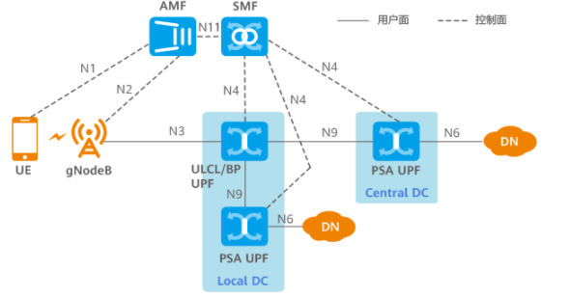
I-UPF, UPF-PSA, ULCL/BP UPF
Notes:
PSA UPF: 最接近 DN 的 UPF
I-UPF: 介於 gNB 與 UPF (PSA) 的 UPF
ULCL UPF: UL classifier UPF，負責上行的分流

Slide 49
Step 6a (conditional)
N4 Session Modification Request
Depending on the network deployment, the CN Tunnel Info of UPF (PSA) allocated for N3 or N9 interface may be changed during the Service Request procedure, e.g. UPF connected to different IP domains.
If different CN Tunnel Info need be used, the SMF sends N4 Session Modification Request message to UPF (PSA) and requests CN Tunnel Info providing the target Network Instance.
Notes:
取決於網絡部署，UPF (PSA) 的 CN Tunnel Info 分配給 N3/N9 的 interface 可能會在 service request 期間有所改變
例如 UPF 連接到不同的 IP domain。
如果需要使用不同的 CN Tunnel Info，則SMF 將 N4 Session Modification Request message 發送給UPF (PSA)，並請求 CN Tunnel Info 然後提供給目標的 Network Instance。

Slide 50
Step 6b (conditional)
N4 Session Modification Response
The UPF (PSA) provides CN Tunnel Info to the SMF.
The UPF (PSA) associate the CN Tunnel Info with UL Packet detection rules provided by the SMF
If the redundant I-UPFs are used for URLLC,
each I-UPF provides UL CN Tunnel Info for N3 interface to the SMF
If the redundant N3 tunnels are used for URLLC,
the UPF (PSA) provides redundant UL CN Tunnel Info for N3 interface to the SMF
Notes:
UPF（PSA）向 SMF 發送 N4 Session Modification Response message。
UPF 提供 CN Tunnel Info 給 SMF。
UPF(PSA) 會將 CN Tunnel Info 與 SMF 提供的 UL Packet detection rules 相關聯。
若為了實現 URLLC 而使用 redundant I-UPF，則
每個 I-UPF 提供了 N3 interface 的 UL CN Tunnel Info 給 SMF
如果為了實現 URLLC 而使用 redundant N3 tunnels，則
- UPF (PSA) 會提供 N3 interface 的 redundant UL CN Tunnel Info 給 SMF

Slide 51
Step 6c (conditional)
SMF to new I-UPF: N4 Session Establishment Request is sent
if the SMF selects a new UPF to act as intermediate UPF for the PDU Session; or
if the SMF selects to insert an intermediate UPF for a PDU Session which did not have an intermediate UPF
N4 Session Establishment Request provides
Packet detection
Data forwarding
enforcement and reporting rules
The CN Tunnel Info (on N9) of PSA is also provided to the intermediate UPF
Notes:
SMF 在以下情況下會傳送 N4 Session Establishment Request 給 new I-UPF:
如果 SMF 選擇了 new UPF 當作是 PDU Session 的 I-UPF; 或者
如果 SMF 選擇插入一個 I-UPF 到 PDU Session
N4 Session Establishment Request 提供了
Packet detection
Data forwarding
enforcement and reporting rules
PSA 在 N9 的 CN Tunnel Info 也會被提供給 I-UPF

Slide 52
Step 6c (conditional)
If a new UPF is selected by the SMF to replace the old (intermediate) UPF
the SMF may also include a request for the new UPF to allocate a second tunnel endpoint for buffered DL data from the old I-UPF
and to indicate via usage reporting end marker reception on this second tunnel
the UPF is instructed by the SMF to buffer the DL data it may receive at the same time from the UPF (PSA)
Notes:
如果新的 UPF 被 SMF 用來取代舊的 UPF
SMF 可能會請求新的 UPF 分配第二個 tunnel endpoint，目的是為了接收從 old I-UPF 過來的 buffered DL data
並且在這第二條 tunnel 上利用 end marker reception 判斷 DL data 已經傳送完畢
在此同時，他也要根據 SMF 的指示把從 UPF (PSA) 那裡收到的 DL data 給暫存起來

Slide 53
Step 6d (conditional)
New I-UPF to SMF: N4 Session Establishment Response
provides DL CN Tunnel Info as requested by SMF
The SMF starts a timer, to be used in step 22a to release the resource in old intermediate UPF if there is one
Notes:
New I-UPF 回傳 N4 Session Establishment Response 給 SMF
- 提供 DL CN Tunnel Info 給 SMF
SMF 觸發一個 timer，等待歸零了就會釋放 old I-UPF 的所有資源 (步驟 22a)

Slide 54
Step 7a (Conditional)
SMF to UPF (PSA): N4 Session Modification Request
If the SMF selects a new UPF to act as intermediate UPF for the PDU Session, the SMF sends N4 Session Modification Request message to UPF (PSA), providing DL Tunnel Info from new intermediate UPF.
UPF (PSA) begins to send the DL data to the new I-UPF
UPF (PSA) sends one or more "end marker" packets for each N9 tunnel to the old I-UPF immediately after switching the path to new I-UPF
Notes:
SMF 傳送 N4 Session Modification Request 給 UPF (PSA)
如果 SMF 選擇了新的 UPF 來當作 I-UPF，SMF 會傳送 N4 Session Modification Request 給 UPF (PSA)，提供 new I-UPF 的 DL Tunnel Info
UPF (PSA) 於是乎開始傳送 DL data 給 new I-UPF
UPF (PSA) 在切換到新的 I-UPF 後，立即利用 N9 tunnel 傳送 end marker 給每一個 old I-UPF

Slide 55
Step 7a (Conditional)
If the Service Request is triggered by the network and the SMF removes the old I-UPF but does not replace it with a new I-UPF, the SMF may also:
include a request for the UPF (PSA) to allocate a second tunnel endpoint for buffered DL data from the old I-UPF
and to indicate end marker reception on this second tunnel via usage reporting
In this case, the UPF (PSA) begins to buffer the DL data it may receive at the same time from the N6 interface
The UPF (PSA) sends one or more "end marker" packets for each N9 tunnel to the old I-UPF immediately after switching the path to (R)AN.
Notes:
如果 Service Request 是被 network triggered，並且 SMF 移除了舊的 I-UPF，但是卻沒有用 new I-UPF 取代，則 SMF 可能也會做以下的動作:
請求 UPF (PSA) 分配第二個 tunnel endpoint 給 old I-UPF 來進行 buffered DL data forwarding
並且透過 usage reporting 來顯示 end marker reception
在此種情況下，此時 UPF (PSA) 開始暫存從 N6 interface 收到的 DL data
在切換路徑到 RAN 之後， UPF (PSA) 會立即傳送一個或多個 end marker 給每一個 N9 interface 上的 old I-UPF。

Slide 56
Step 7b
The UPF (PSA) sends N4 Session Modification Response message to SMF
The UPF (PSA) sends DL CN tunnel info for the old I-UPF to the SMF.
The SMF starts a timer, to be used in step 22a to release the resource in old intermediate UPF if there is one.
Notes:
UPF PSA 回傳 N4 Session Establishment Response 給 SMF
UPF PSA 提供 DL CN Tunnel Info 回給 SMF
SMF 開始一個timer，歸零時會釋放 old I-UPF 的資源 (步驟 22a)

Slide 57
Step 7b
If the UPF that connects to RAN is the UPF (PSA) and if the SMF finds that the PDU Session is activated when receiving the Nsmf_PDUSession_UpdateSMContext Request in step 4 with Operation Type set to "UP activate" to indicate establishment of User Plane resources for the PDU Session(s), it deletes the AN Tunnel Info and initiates an N4 Session Modification procedure to remove Tunnel Info of AN in the UPF.
Notes:
如果 連接到 RAN 的 UPF 是 UPF (PSA) 並且 SMF 發現在 step 4 收到 Nsmf_PDUSession_UpdateSMContext Request 時，Operation Type 被設成 UP activate，也就是說 PDU Session 被 activated 了，那 SMF 就會發起 N4 Session Modification procedure 來移除在 UPF (PSA) 裡面的 AN Tunnel Info

Slide 58

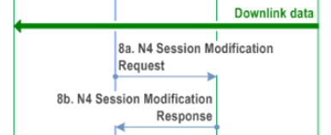
Step 8a (Conditional)
SMF to old UPF (intermediate):
N4 Session Modification Request
New UPF address
New UPF DL Tunnel ID
If the SMF allocated new I-UPF, the DL Tunnel Info is from the new I-UPF acting as N3 terminating point.
If the SMF did not allocate a new I-UPF, the DL Tunnel Info is from the new UPF (PSA) acting as N3 terminating point.
Notes:
步驟 8a
SMF 傳送 N4 Session Modification Request 給 UPF，裡面包含:
New UPF address
New UPF DL Tunnel ID
如果 SMF 分配了 new I-UPF，則 DL Tunnel Info 是 new I-UPF 過來的並且當作是 N3 terminating point
如果 SMF 沒有分配 new I-UPF，則 DL Tunnel Info 是 UPF (PSA) 過來的並且當作是 N3 terminating point

Slide 59
Step 8b
old UPF (intermediate) to SMF: N4 Session Modification Response

Slide 60
SMF
N4
N4
Old I-UPF
N9
N6
gNB
N3
UPF (PSA)
DN
N3
N9
SMF
New I-UPF
N4
N4
N9
N3
N6
gNB
Old I-UPF
UPF (PSA)
DN
SMF
N4
N4
Old I-UPF
N3
N6
gNB
UPF (PSA)
DN
N3
DL
Buffered DL data
Notes:
這是我自己畫的概念圖，在經過一系列 N4 Modification/Establishment 後，DL 的資料流就會類似這樣

Slide 61
Step 9 (conditional)
old I-UPF to new I-UPF: buffered downlink data forwarding.
If the I-UPF is changed and forwarding tunnel was established to the new I-UPF, the old I-UPF forwards its buffered data to the new (intermediate) UPF acting as N3 terminating point.
Notes:
在這個階段，舊的 I-UPF 會 forward DL buffered data 給新的 I-UPF，新的 I-UPF 的接點是 N3 terminating point

Slide 62
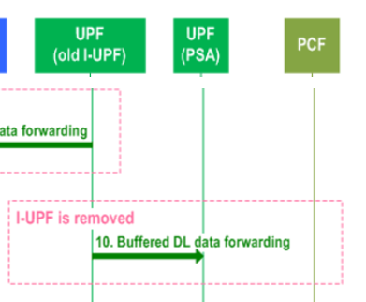
Step 10 (conditional)
old UPF (intermediate) to UPF (PSA): buffered downlink data forwarding
If the old I-UPF is removed and no new I-UPF is assigned for the PDU Session and forwarding tunnel was established to the UPF (PSA), the old (intermediate) UPF forwards its buffered data to the UPF (PSA) acting as N3 Terminating Point.
Notes:
第 10 步跟第 9 步差不多，只不過這是 new I-UPF 不存在的情況，old I-UPF 會把 buffered DL data forward 到 UPF (PSA)

Slide 63
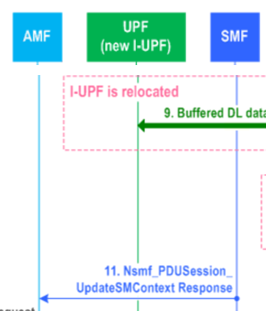
Step 11 (Conditional)
Nsmf_PDUSession_UpdateSMContext Response
N2 SM information (AMF -> NG-RAN)
PDU Session ID
QFI(s)
QoS profile(s)
CN N3 Tunnel Info
S-NSSAI
User Plane Security Enforcement
UE Integrity Protection Maximum Data Rate
RSN
PDU Session Pair ID
N1 SM Container (AMF -> UE)
Cause
Notes:
第 11 步，SMF 回給 AMF Nsmf_PDUSession_UpdateSMContext Response 包含了以下資訊:
N2 SM information (AMF 給 NG-RAN)
PDU Session ID
QFI(s)
QoS profile(s)
CN N3 Tunnel Info
S-NSSAI
User Plane Security Enforcement
UE Integrity Protection Maximum Data Rate
RSN
PDU Session Pair ID
N1 SM Container (AMF 給 UE)
Cause

Slide 64
Step 11 (Conditional)
CN N3 Tunnel Info is
the UL CN Tunnel Info of the UPF (PSA); or
the UL Tunnel Info of the new I-UPF
For the PDU Session with redundant I-UPFs or with redundant N3 tunnels for URLLC
two UL N3 CN Tunnel Info are included
SMF also indicates the NG-RAN that one of the CN Tunnel Info is used as the redundancy tunnel of the PDU session
Notes:
CN N3 Tunnel Info 有可能是
the UL CN Tunnel Info of the UPF (PSA); 或者
the UL Tunnel Info of the new I-UPF
若 PDU Session 擁有 Redundant I-UPFs 或是為了 URLLC 而擁有 redundant N3 tunnels，則
2 個 UL N3 CN Tunnel Infos 會被包含進去
SMF 會告訴 NG-RAN，其中一個 CN Tunnel Info 是被拿來當成 PDU Session 的 redundancy tunnel

Slide 65
Step 11 (Conditional)
The SMF shall send N1 SM Container and/or N2 SM Information to the AMF when applicable.
For a PDU Session that the SMF has determined to accept the activation of UP connection in step 5a or 5b, the SMF generates only N2 SM information and sends Nsmf_PDUSession_UpdateSMContext Response to the AMF to establish the User Plane(s).
SMF may indicate redundant transmission indicator for each QoS Flow
Notes:
(當可以傳送的時候) SMF 必須傳送 N1 SM Container 以及 N2 SM Information 給 AMF
對於那些在步驟 5a 或 5b 時，SMF 已經 accept 要 activate 的 UP connection 的 PDU Session 而言，SMF 只會產生 N2 SM information 並傳送 Nsmf_PDUSession_UpdateSMContext Response 給 AMF 來建立 User Plane(s)
- SMF 可能會顯示 redundant transmission indicator for each QoS Flow

Slide 66
Step 11 (Conditional)
If the SMF decided to change the PSA UPF for the SSC mode 3 PDU Session, the SMF triggers an independent procedure (described in clause 4.3.5.2 or clause 4.3.5.3) after accepting the activation of UP of the PDU Session.
Notes:
若 SMF 決定要改變 UPF (PSA) 針對 SSC mode 3 的 PDU Session，SMF 會在 accept activation of UP of the PDU Session 之後，觸發獨立的 procedure ，這個 procedure 定義在 clause 4.3.5.2 or clause 4.3.5.3

Slide 67
Step 11 (Conditional)
The SMF can reject the activation of UP of the PDU Session by including a Cause in the Nsmf_PDUSession_UpdateSMContext Response. Following are some of the cases:
If the PDU Session corresponds to a LADN and the UE is outside the area of availability of the LADN as described in step 5b;
If the AMF notified the SMF that the UE is reachable only for regulatory prioritized service and the PDU Session to be activated is not for a regulatory prioritized service; or
If the SMF decided to change the PSA UPF for the requested PDU Session as described in step 5b. In this case, after sending Nsmf_PDUSession_UpdateSMContext Response, the SMF triggers another procedure to instruct UE to re-establish the PDU Session as described in clause 4.3.5.1 for SSC mode 2.
If the SMF received negative response in Step 6b due to UPF resource unavailability.
Notes:
SMF 也可能會 Reject the activation of UP of the PDU Session 透過包含 Cause 在 Nsmf_PDUSession_UpdateSMContext Response。以下是其中的一些 cases:
- 如步驟 5b 中所述，PDU Session 對應於 LADN 並且 UE 在 LADN 的可用性範圍之外
- AMF 通知 SMF 該 UE 僅可用於regulatory prioritized service，並且 PDU Session to be activated 不用於 regulatory prioritized service
- 如步驟 5b中所述，SMF 決定為 requested PDU Session 更改 PSA。在這種情況下，在發送 Nsmf_PDUSession_UpdateSMContext response 之後，SMF 會觸發另一個過程以指示 UE 重新建立 PDU Session，如 4.3.5.1 節中針對 SSC mode 2 所述。
- UPF 資源不可用，SMF 在步驟 6b 中收到 negative response。

Slide 68
Step 11 (Conditional)
If the PDU Session has been assigned any EPS bearer ID, the SMF also includes the mapping between the SMF also includes the mapping between EPS bearer ID(s) and QFI(s) into the N2 SM information into the N2 SM information
The User Plane Security Enforcement information is determined by the SMF upon PDU session establishment. If the User Plane Security Enforcement information indicates that Integrity Protection is "Preferred" or "Required", the SMF also includes the UE Integrity Protection Maximum Data Rate
Notes:
如果 PDU Session 被賦予了任何的 EPS bearer ID，SMF 也會把介於 EPS bearer ID(s) 及 QFI(s) 之間的 mapping 給包含進 N2 SM information 裡面
一旦 PDU session 被建立，SMF 就會決定 User Plane Security Enforcement information，如果 User Plane Security Enforcement information 顯示 Integrity Protection 為 Preferred 或 Required，SMF 也必須要包含 UE Integrity Protection Maximum Data Rate

Slide 69
Step 12
N2 Request
N2 SM information received from SMF
security context
Mobility Restriction List
UE-AMBR
List of UE-Slice-MBR(s) (optional and for 3GPP access type only)
MM NAS Service Accept
list of recommended cells / TAs / NG-RAN node identifiers
UE Radio Capability
Core Network Assistance Information
Tracing Requirements
UE Radio Capability ID
Notes:
第12步，RAN 傳送給 AMF 的 N2 Request 包含以下資訊:
N2 SM information received from SMF
security context
Mobility Restriction List
UE-AMBR
List of UE-Slice-MBR(s) (optional and for 3GPP access type only)
MM NAS Service Accept
list of recommended cells / TAs / NG-RAN node identifiers
UE Radio Capability
Core Network Assistance Information
Tracing Requirements
UE Radio Capability ID

Slide 70
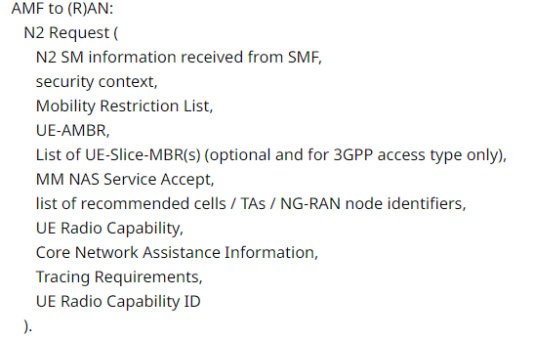
Step 12
If the subscription information includes Tracing Requirements, the AMF includes it in the N2 Request.
Notes:
如果訂閱資訊包含 Tracing Requirements，則 AMF 將它包含進 N2 Request

Slide 71
Step 12
If the UE triggered the Service Request while in CM-CONNECTED state, only N2 SM information received from SMF and MM NAS Service Accept are included in the N2 Request.
Notes:
若是 UE triggered 的 Service Request 且 UE 在 CM-CONNECTED state，只有從 SMF 那裡收到的 N2 SM information 及 MM NAS Service Accept 會被包含進 N2 Request
若是 Network triggered 的 Service Request 且 UE 在 CM-CONNECTED state，只有從 SMF 那裡收到的 N2 SM information 會被包含進 N2 Request

Slide 72
Step 12
If the Service Request procedure is triggered by the Network while the UE is in CM-CONNECTED state, only N2 SM information received from SMF is included in the N2 Request.
Notes:
若是 Network triggered 的 Service Request 且 UE 在 CM-CONNECTED state，只有從 SMF 那裡收到的 N2 SM information 會被包含進 N2 Request

Slide 73
Step 12
If the Service Request procedure is triggered by the Network while the UE is in CM-IDLE state, only N2 SM information received from SMF and MM NAS Service Accept is included in the N2 Request.
Notes:
若是 Network triggered 的 Service Request 且 UE 在 CM-IDLE state，只有從 SMF 那裡收到的 N2 SM information 及 MM NAS Service Accept 會被包含進 N2 Request

Slide 74
Step 12
Service Request | CM-IDLE | CM-CONNECTED
UE triggered |  | N2 SM information MM NAS Service Accept
Network triggered | N2 SM information MM NAS Service Accept | N2 SM information
Notes:
上面三張投影片整理成 table

Slide 75
Step 12
For a UE that was in CM-IDLE state when the Service Request was triggered, the NG-RAN stores the Security Context.
If the Service Request is not triggered by UE for a signalling connection only, RAN also stores QoS Information for the QoS Flows of the PDU Sessions that are activated and N3 Tunnel IDs in the UE RAN context and Mobility Restriction List
Notes:
若 UE 在 CM-IDLE state 的情況下觸發 Service Request，則 NG-RAN 會儲存 Security Context
如果 Service Request 不是只有被用作 signaling connection only，則 RAN 也會儲存 QoS 資訊 for the QoS flows 並放在 UE RAN context，以及儲存 Mobility Restriction List。

Slide 76
Step 12
MM NAS Service Accept includes PDU Session status in AMF. Any local PDU Session Release during the Session Request procedure is indicated to the UE via the Session Status.
PDU Session Reactivation Result is provided in Service Accept for the PDU sessions in the List Of PDU Sessions To Be Activated and the PDU Session in the List of Allowed PDU Sessions which has caused paging or NAS notification.
If the PDU Session Reactivation Result of a PDU Session is failure, the cause of the failure is also provided.
Notes:
MM NAS Service Accept 包含了 AMF 內的 PDU Session 狀態。任何 local 的 在 Session Request procedure 期間的 PDU Session Release 都會被顯示給 UE 看，透過 Session Status。
針對在 List Of PDU Sessions To Be Activated 裡面導致 paging 或 NAS notification 的 PDU Sessions，PDU Session Reactivation Result 也會被包在 Service Accept 裡面。
如果對於某個 PDU Session 的 PDU Session Reactivation Result 是顯示為失敗，則失敗的 Cause 也會被提供出來。

Slide 77
Step 12
If the AMF accepts the Paging Restriction Information sent from the UE, the AMF informs the UE about the acceptance/rejection of the requested Paging Restriction Information in the MM NAS Service Accept message.
Notes:
如果 AMF 接受了 UE 傳送過來的 Paging Restriction Information，AMF 會在 MM NAS Service Accept message 內通知 UE 關於 requested Paging Restriction Information 是接受還是拒絕。

Slide 78
Step 12
If AMF receives multiple TAIs from the NG-RAN in step 2 and determines that some, but not all of them are forbidden by subscription or by operator policy, the AMF shall include the forbidden TAI(s) in the MM NAS Service Accept message.
Notes:
如果 AMF 在 step 2 從 NG-RAN 那裡收到多個 TAI，但不是所有的 TAI 都被 subscription 或 operator policy 禁止，則 AMF 應該要將 forbidden TAI(s) 包在 MM NAS Service Accept message 內。

Slide 79
Step 12
If there are multiple PDU Sessions that involves multiple SMFs, AMF does not need to wait for responses from all SMFs in step 11 before it sends N2 SM information to the RAN.
However, the AMF shall wait for all responses from the SMFs before it sends MM NAS Service Accept message to the UE.
Notes:
若有多個 PDU Sessions 牽涉到多個 SMFs，AMF 沒必要等到所有的 SMF 都回應才傳送 N2 SM information 給 RAN。
但是，AMF 必須要等到收到所有 SMFs 的回應，才能夠回 MM NAS Service Accept message 給 UE。

Slide 80
Step 12
AMF shall include at least one N2 SM information from SMF if this step is triggered for PDU Session User Plane activation.
AMF may send additional N2 SM information from SMFs in separate N2 message(s) (e.g. N2 tunnel setup request), if there is any.
Alternatively, if multiple SMFs are involved, the AMF may send one N2 Request message to (R)AN after all the Nsmf_PDUSession_UpdateSMContext Response service operations from all the SMFs associated with the UE are received.
Notes:
若此步驟是為了觸發 PDU Session User Plane activation，則 AMF 應該要包含至少一個從 SMF 得到的 N2 SM information。
AMF 可能會從 SMFs 轉送額外的 N2 SM information，例如 N2 tunnel setup request，如果有的話。
或者，如果多個 SMFs 參與進來，AMF 可能會在收到所有的 Nsmf_PDUSession_UpdateSMContext Response 之後，傳送一個 N2 Request message。

Slide 81
Step 12
If the NG-RAN node had provided the list of recommended cells / TAs / NG-RAN node identifiers during the AN Release procedure (see clause 4.2.6), the AMF shall include it in the N2 Request. The NG-RAN may use this information to allocate the RAN Notification Area when the NG-RAN decides to enable RRC_INACTIVE state for the UE.
Notes:
此頁同 step 3a (本投影片第31頁)，不多贅述。

Slide 82
Step 12
Skipped
RACS
Core Network Assistance Information
Enhanced Coverage Restricted information
MICO mode
Notes:
RACS 相關，不贅述。

Slide 83
Step 13
The NG-RAN performs RRC Connection Reconfiguration with the UE depending on the QoS Information for all the QoS Flows of the PDU Sessions whose UP connections are activated and Data Radio Bearers.
For a UE that was in CM-IDLE state,
if the Service Request is not triggered by UE for a signalling connection only, the User Plane security is established at this step
if the Service Request is triggered by UE for a signalling connection only, AS security context may be established in this step
Notes:
NG-RAN 執行 RRC Connection Reconfiguration 依據被激活的所有的 PDU Sessions 的 QoS Flows 的 QoS Information，
針對在 CM-IDLE 狀態的 UE:
如果 Service Request 不是只有被 UE 拿來觸發 signalling connection，則 User Plane security 會在此步驟被建立。
如果 Service Request 是只有被 UE 拿來觸發 signalling connection，則 AS security context 會在此步驟被建立。

Slide 84
Step 13
If the N2 Request includes a NAS message, the NG-RAN forwards the NAS message to the UE.
The UE locally deletes context of PDU Sessions that are not available in 5GC.
NOTE: The reception of the Service Accept message does not imply the successful activation of the User Plane radio resources.
Notes:
如果 N2 Request 包含 NAS message，則NG-RAN 轉送 NAS message 給 UE。
如果在 5GC 不可用，UE 會自己刪除 PDU Sessions 的 context。
注意 !! 收到 Service Accept 不代表成功激發 User Plane radio resources。

Slide 85
Step 13
After the User Plane radio resources are setup, the UL data from the UE can now be forwarded to NG-RAN. The NG-RAN sends the uplink data to the UPF address and Tunnel ID provided in the step 11.
Notes:
在 UP radio resource 被建立好後，UL data 就可以從 UE 被 forwarded 到 NG-RAN。NG-RAN 傳送 UL data 到 UPF address 以及步驟 11 提供的 Tunnel ID。

Slide 86
Step 13
After the User Plane radio resources are setup, the UL data from the UE can now be forwarded to NG-RAN. The NG-RAN sends the uplink data to the UPF address and Tunnel ID provided in the step 11.
Notes:
在 UP radio resource 被建立好後，UL data 就可以從 UE 被 forwarded 到 NG-RAN。NG-RAN 傳送 UL data 到 UPF address 以及步驟 11 提供的 Tunnel ID。

Slide 87
Step 14 (Conditional)
N2 Request Ack
List of PDU Sessions To Be Established with N2 SM information
AN Tunnel Info
List of accepted QoS Flows for the PDU Sessions whose UP connections are activated
List of rejected QoS Flows for the PDU Sessions whose UP connections are activated
List of PDU Sessions that failed to be established with the failure cause given in the N2 SM information element

Slide 88
Step 14 (Conditional)
The message may include N2 SM information(s)
e.g. AN Tunnel Info
NG-RAN may respond N2 SM information with separate N2 message (e.g. N2 tunnel setup response) if AMF sends separate N2 message in step 11.
If multiple N2 SM information are included in the N2 Request message in step 12, the N2 Request Ack includes multiple N2 SM information and information to enable the AMF to associate the responses to relevant SMF.
Notes:
此 message 包含了 N2 SM 的資訊，例如 AN Tunnel Info
如果 AMF 在第11部，傳送分離的 N2 message，NG-RAN 根據不同的 N2 message 來做回應。
如果在步驟 12 有多個 N2 SM 資訊被包在 N2 Request 裡面，則 N2 Request Ack 包含了複數個 N2 SM 資訊，並且附上能夠讓 AMF 關連到不同 SMF 的資訊。

Slide 89
Step 15 (Conditional)
Nsmf_PDUSession_UpdateSMContext Request per PDU Session to the SMF
N2 SM information
RAT Type (AMF determine)
Access Type (AMF determine)
Notes:
Nsmf_PDUSession_UpdateSMContext Request 包含了:
N2 SM information
RAT Type (由 AMF 決定)
Access Type (由 AMF 決定)

Slide 90
Step 15 (Conditional)
If the AMF received N2 SM information (one or multiple) in step 14, then the AMF shall forward the N2 SM information to the relevant SMF per PDU Session ID.
If the UE Time Zone has changed compared to the last reported UE Time Zone then the AMF shall include the UE Time Zone IE in this message.
Notes:
如果 AMF 在第 14 步收到一個或多個 N2 SM information，AMF 應該要 forward N2 SM information 給相對應的 SMF 針對每個 PDU Session ID。
如果 UE 的時區有變，AMF 應該要將 UE 的時區 IE 包進這個 message 裡。

Slide 91
Step 15 (Conditional)
If the PDU Session is moved from the non-3GPP access to 3GPP access (i.e. N3 tunnel for the PDU Session is established successfully)
the SMF and AMF update associated access of the PDU Session
the UE updates associated access of the PDU Session when the user plane resource for the PDU Session is successfully established
Notes:
若 PDU Session 被從 non-3GPP 移動到 3GPP access，也就是說 N3 tunnel 成功被建立起來。
SMF 與 AMF 都要更新 associated access
當 user plane resource 被成功建立時，UE 更新 associated access

Slide 92
Step 15 (Conditional)
If a PDU Session is rejected by the serving NG-RAN with an indication that the PDU Session was rejected because User Plane Security Enforcement is not supported in the serving NG-RAN and the User Plane Enforcement Policy indicates "Required" as described in clause 5.10.3 of TS 23.501, the SMF shall trigger the release of this PDU Session.
In all other cases of PDU Session rejection, the SMF can decide whether to release the PDU Session or to deactivate the UP connection of this PDU Session.
Notes:
若 PDU Session 被 serving NG-RAN 拒絕，原因是因為 User Plane Security Enforcement 不被支援，但 User Plane Enforcement Policy 顯示 “Required”， SMF 必須釋放此 PDU Session。
對於其他的 PDU Session rejection cases，SMF 可以自行決定是否要釋放 PDU Session 或者 deactivate UP connection

Slide 93
Step 15 (Conditional)
If some of the QoS Flows of a PDU Session are not accepted by the serving NG-RAN, the SMF shall initiate the PDU Session Modification procedure to remove the non-accepted QoS Flows from the PDU Session after this procedure is completed.
Notes:
若有些 QoS Flows 沒有被 serving NG-RAN 接受，SMF 應該要在這個 procedure 之後發起 PDU Session Modification procedure 來移除不被接受的 QoS Flows。

Slide 94
Step 16 (Conditional)
If dynamic PCC is deployed and if Policy Control Request Trigger condition(s) have been met (e.g. change of Access Type, change of UE location), performs SMF initiated SM Policy Modification procedure as defined in clause 4.16.5.1. The PCF may provide updated policies.
Notes:
若動態 PCC 被部屬且若 Policy Control Request Trigger condition(s) 有符合 (例如: Access Type 改變、UE Location 改變)，SMF 會發起 SM Policy Modification procedure，PCF 會提供更新過後的政策。

Slide 95
Step 17a (Conditional)
N4 Session Modification Request
AN Tunnel Info
List of accepted QFI(s)
If the SMF selected a new I-UPF for the PDU Session in step 5b, the SMF initiates a N4 Session Modification procedure to the new I-UPF and provides AN Tunnel Info.
The DL Data from the new I-UPF can now be forwarded to NG-RAN and UE.
Notes:
N4 Session Modification Request 包含了:
AN Tunnel Info
List of accepted QFI(s)
如果 SMF 在 步驟5b 選擇了新的 I-UPF，SMF 會對 new I-UPF 發起 N4 Session Modification procedure 並提供 AN Tunnel Info。
於是 DL data 現在可以被 forward 到 NG-RAN 及 UE 了。

Slide 96
Step 17b (Conditional)
N4 Session Modification Response

Slide 97
Step 18a (Conditional)
N4 Session Modification Request
AN Tunnel Info
List of rejected QoS Flows
Notes:
N4 Session Modification Request 包含了:
AN Tunnel Info
List of rejected QoS Flows

Slide 98
Step 18a (Conditional)
If a User Plane is to be setup or modified and after the modification there is no I-UPF, the SMF initiates a N4 Session Modification procedure to UPF (PSA) and provides AN Tunnel Info.
The DL Data from the UPF (PSA) can now be forwarded to NG-RAN and UE.
Notes:
若 User Plane 將要被建立或修改，並且在這之後沒有 I-UPF 存在，則 SMF 會對 UPF (PSA) 發起 N4 Session Modification procedure 並提供 AN Tunnel Info。
於是 DL data 現在可以被 forward 到 NG-RAN 及 UE 了。

Slide 99
Step 18a (Conditional)
For QoS Flows in the List of rejected QoS Flows, the SMF shall instruct the UPF to remove the rules (e.g. Packet Detection Rules etc.) which are associated with the QoS Flows.
Notes:
對於在 List of rejected QoS Flows 裡面的 QoS Flows，SMF 應該要去引導 UPF 移除與 QoS Flows 相關聯的 rules (例如: Packet Detection Rules 等)

Slide 100
Step 18a (Conditional)
If SMF decides to perform redundant transmission for one or more QoS Flows of the PDU, the SMF also indicates the UPF (PSA) to perform packet duplication for the QoS Flow(s) in DL direction by forwarding rules.
If the PCC rule(s) are updated in step 16, the SMF may initiate a N4 Session Modification procedure to UPF (PSA) based on the updated PCC rule(s).
Notes:
若 SMF 決定針對一個或多個 QoS Flow 執行 redundant transmission，SMF 也要告訴 UPF (PSA) 執行 packet duplication 針對該 QoS Flow(s) 的 DL 方向，利用 forwarding rules。
若 PCC rule(s) 有在第16步被更新，SMF 會對 UPF (PSA) 發起 N4 Session Modification procedure 基於更新過後的 PCC rule(s)。

Slide 101
Step 18b (Conditional)
N4 Session Modification Response
Notes:
若 SMF 決定針對一個或多個 QoS Flow 執行 redundant transmission，SMF 也要告訴 UPF (PSA) 執行 packet duplication 針對該 QoS Flow(s) 的 DL 方向，利用 forwarding rules。
若 PCC rule(s) 有在第16步被更新，SMF 會對 UPF (PSA) 發起 N4 Session Modification procedure 基於更新過後的 PCC rule(s)。

Slide 102
Step 19 (Conditional)
Nsmf_PDUSession_UpdateSMContext Response

Slide 103
Step 20a (Conditional)
If forwarding tunnel has been established to the new I-UPF and if the timer SMF set for forwarding tunnel at step 8a has expired, SMF sends N4 Session modification request to new I-UPF acting as N3 terminating point to release the forwarding tunnel.
Notes:
若 forwarding tunnel 在 new I-UPF 有被建立起來，並且如果 SMF 設定針對 forwarding tunnel 的 timer 歸零了，SMF 傳送 N4 Session modification request 給 new I-UPF 的 N3 termination point 來釋放 forwarding tunnel。

Slide 104
Step 20b (Conditional)
New I-UPF acting as N3 terminating point sends N4 Session Modification response to SMF
Notes:
若 forwarding tunnel 在 new I-UPF 有被建立起來，並且如果 SMF 設定針對 forwarding tunnel 的 timer 歸零了，SMF 傳送 N4 Session modification request 給 new I-UPF 的 N3 termination point 來釋放 forwarding tunnel。

Slide 105
Step 21a (Conditional)
If forwarding tunnel has been established to the UPF (PSA) and if the timer SMF set for forwarding tunnel at step 7b has expired, SMF sends N4 Session modification request to UPF (PSA) acting as N3 Terminating Point to release the forwarding tunnel.

Slide 106
Step 21b (Conditional)
UPF (PSA) acting as N3 Terminating Point sends N4 Session Modification Response to SMF.

Slide 107
Step 22a (Conditional)
If the SMF decided to continue using the old UPF in step 5b, the SMF sends an N4 Session Modification Request, providing AN Tunnel Info.
If the SMF decided to select a new UPF to act as I-UPF in step 5b and the old UPF is not PSA UPF, the SMF initiates resource release, after timer in step 6b or 7b expires, by sending an N4 Session Release Request (Release Cause) to the old intermediate UPF.

Slide 108
Step 22b (Conditional)
The old UPF acknowledges with an N4 Session Modification Response or N4 Session Release Response message to confirm the modification or release of resources.

